Slide 1
Executive sales analysis
Prepared by: Fathima Arshi
Tools: Microsoft Excel | Pivot Tables | Pivot Charts | Slicers | Timeline
Dataset: Superstore Sales Dataset — Kaggle
July 2026

Slide 2
Executive summary
Analysed 9,994 sales records to evaluate overall business performance.
Prepared transactional data and created calculated fields for analysis.
Developed 8 KPIs covering sales, profitability, customers, orders, and discounts.
Built an interactive Excel dashboard using Pivot Tables, Pivot Charts, Slicers, and Timeline.
Generated business insights and recommendations to support data-driven decision-making.

Slide 3
Business Objectives & Dataset
Business Objectives
Analyse sales and profitability across key business dimensions.
Compare performance by region, category, and customer segment.
Identify monthly trends, top customers, and top products.
Develop an interactive dashboard for performance monitoring.
Dataset
Source: Superstore Sales Dataset — Kaggle
Records: 9,994 | Columns: 21
Key Fields: Order, Customer, Product, Region, Sales, Quantity, Discount, Profit

Slide 4
Data Preparation & Cleaning
Validated the dataset structure, fields, and data types.
Standardized Order Date and Ship Date for time-based analysis.
Converted the dataset into an Excel Table for structured analysis.
Created calculated fields including Order Year, Order Month, Shipping Days, and Profit Margin.
Developed Pivot Tables as the foundation for dashboard analysis.

Slide 5
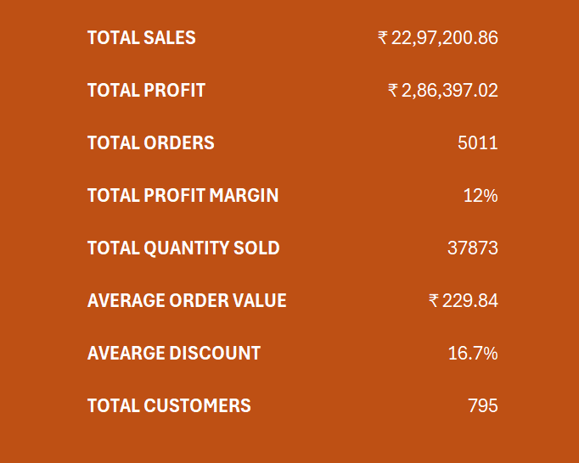
Kpi analysis
Developed 8 KPIs to provide a high-level view of business performance.
Sales & Profit: Total Sales, Total Profit, Profit Margin.
Customer & Order: Distinct Orders, Total Customers, Average Order Value.
Volume & Pricing: Quantity Sold, Average Discount.
KPIs enable quick performance monitoring and comparison.

Slide 6
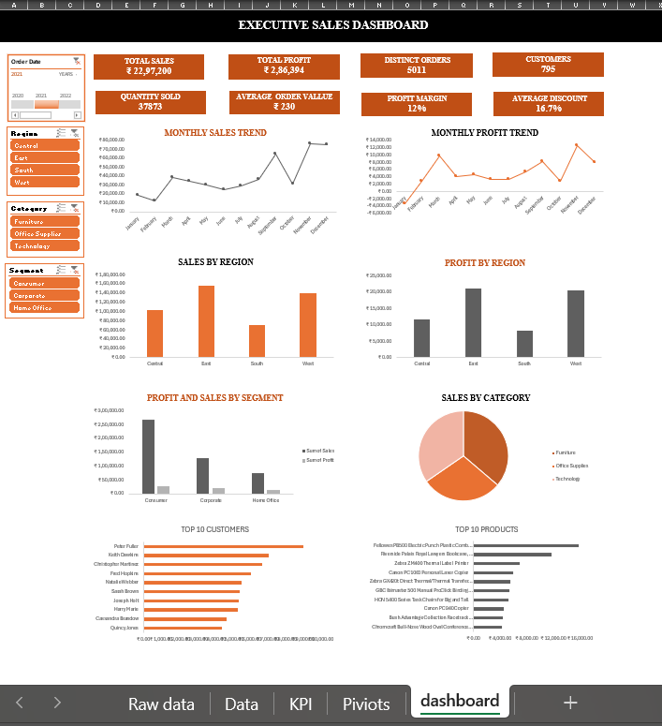
Executive Dashboard

Slide 7
Executive sales dashboard
Developed an interactive Excel dashboard for sales performance monitoring.
Used KPI Cards to present key business metrics.
Used Pivot Charts to analyze regional, category, segment, and monthly performance.
Included Top 10 Customers and Top 10 Products for contribution analysis.
Added Slicers and Timeline for dynamic filtering and data exploration.

Slide 8
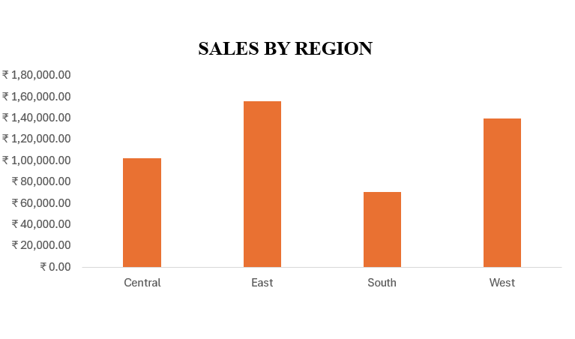
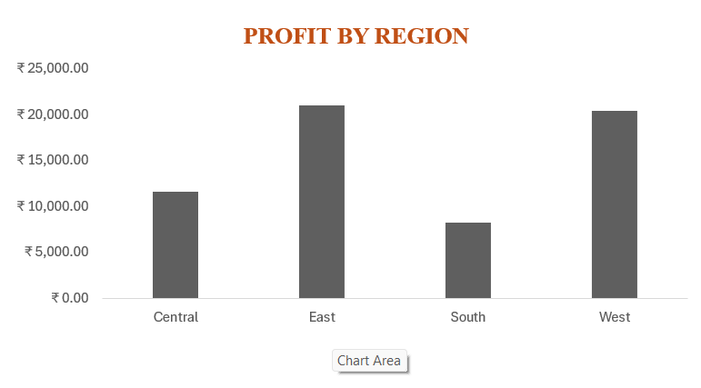
Sales & Profitability Analysis
Generated ₹22,97,200 in Total Sales and ₹2,86,394 in Total Profit.
Achieved an overall Profit Margin of approximately 12%.
West Region recorded the highest sales and profit contribution.
Technology was the highest-performing product category.
Lower-performing regions present opportunities for targeted growth strategies.

Slide 9
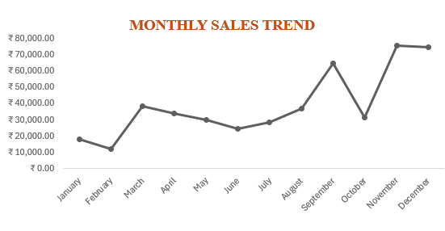
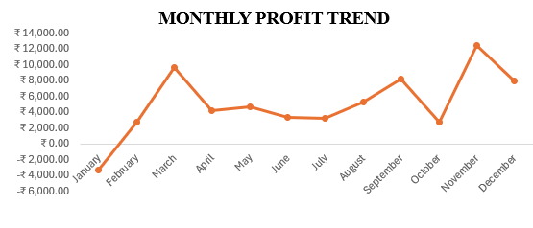
Customer, Product & Trend Analysis
Consumer Segment generated the highest sales contribution.
Identified Top 10 Customers and Top 10 Products based on sales.
Monthly analysis revealed fluctuations in sales and profitability.
Final-quarter performance showed stronger sales and profit trends.
Findings support improved customer retention, inventory planning, and seasonal strategies.

Slide 10
Business Insights & Recommendations
West Region: Maintain successful strategies and explore further expansion.
Technology: Prioritize inventory availability and targeted promotions.
Consumer Segment: Strengthen retention through loyalty and personalized offers.
Seasonal Demand: Plan inventory and campaigns ahead of peak periods.
Discount Strategy: Balance sales growth with profitability through controlled discounting.

Slide 11
Conclusion & Skills Demonstrated
Transformed raw transactional data into actionable business insights.
Built an interactive Executive Sales Dashboard using Microsoft Excel.
Applied data preparation, KPI analysis, Pivot Tables, Pivot Charts, and visualization.
Identified opportunities across regions, categories, customers, products, and trends.
Demonstrated practical Data Analyst and Business Analyst skills.

Slide 12
THANK YOU

